Slide 1

Employee Attrition Model
Logan Bell

Slide 2
Problem Statement
Objective:
Gain a competitive edge in talent management by using data science to improve employee retention
Scope of Analysis:
Key factors which determine attrition
Trends found in job roles
Approach:
Preliminary EDA to determine biggest factors and job role trends
Building naïve Bayes model to get a robust predictive model on attrition
60% in sensitivity and specificity needed

Slide 3
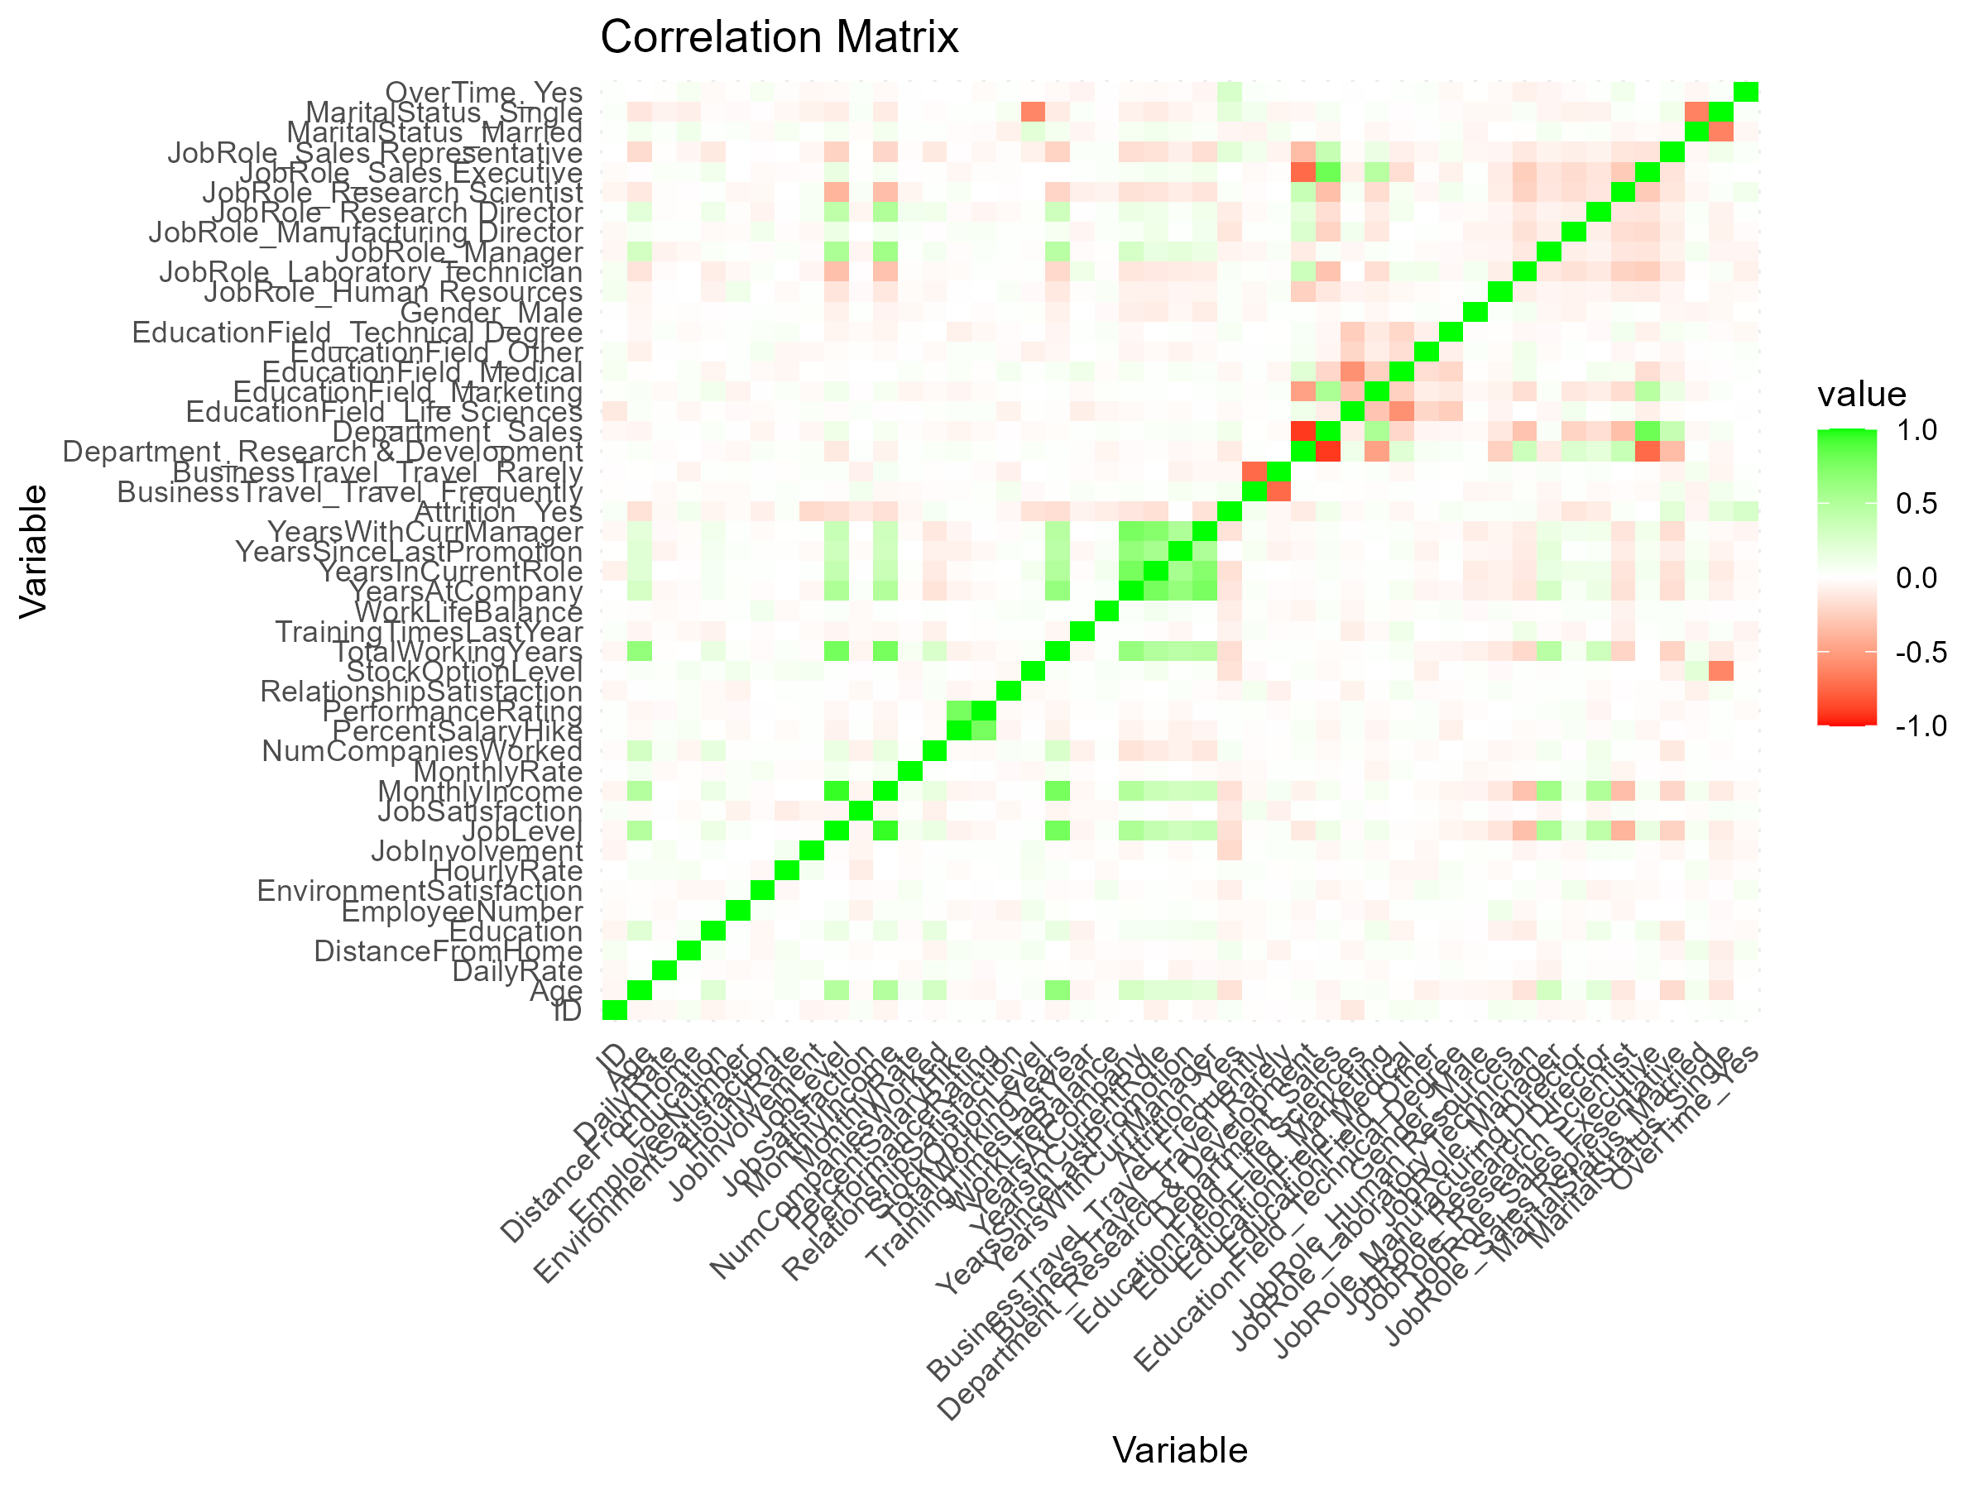
EDA – Correlation Matrix
Very complex correlation matrix made for the various factors in the data set.
Factors with zero variance were removed (like Over18)
Categorical data was transformed to numeric data
The factors with the highest correlation with attrition taken from this to be put in the first stage of the model are: Job Involvement, Job Level, Stock Option Level, Monthly Income, Years in Current Role, Marital Status, Overtime, Job Role, and Total Working Years.

Slide 4
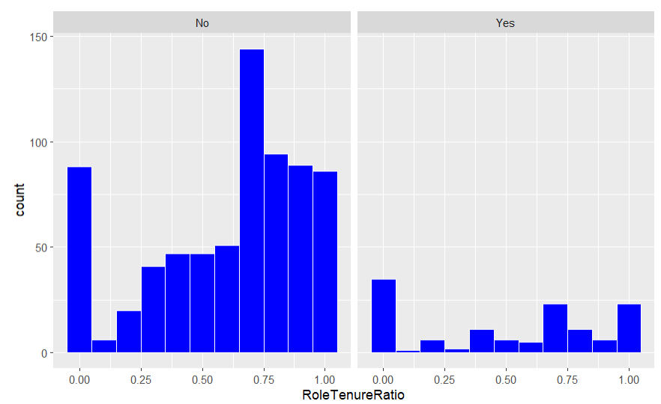
EDA – Role Tenure Ratio
Role Tenure Ratio column was added
Ratio of years in current role and years at current job
Belief that those who stay in a position for too long might move to a different company
Histogram shows similar trends for those who stayed and left, so it does not seem that the role tenure ratio is very important

Slide 5
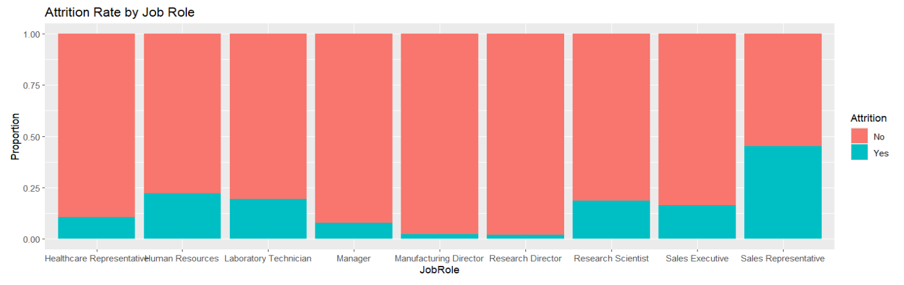
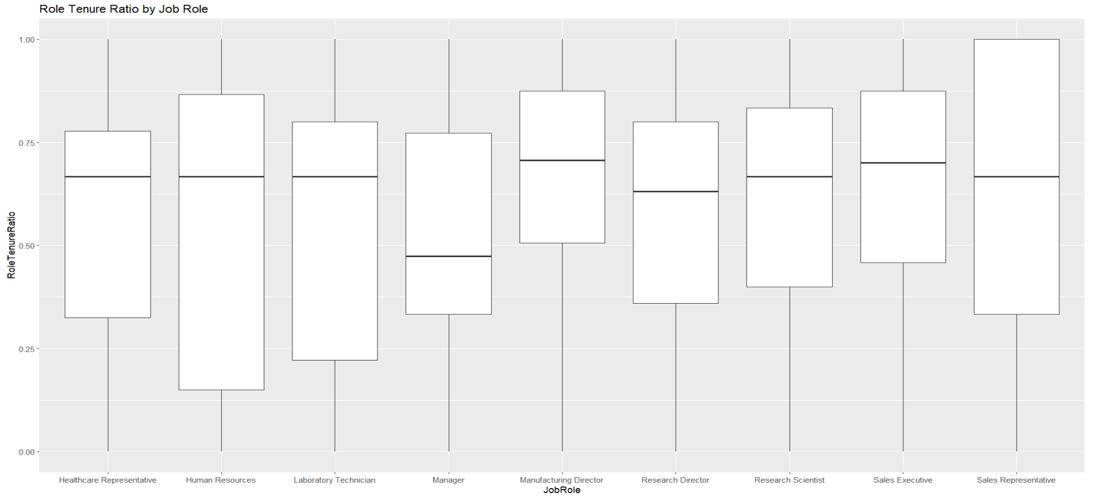
EDA – Job Role Trends
Those with higher positions have less attrition
Lower-level positions have a much higher attrition – especially sales representatives
Sales executives have higher attrition than other managerial positions as well
All positions have somewhat similar role tenure ratios
Would be hard to say they are different

Slide 6

Three Biggest Factors for Attrition
A model which gathered every combination of three variables and ran a naïve Bayes model of each combination was made.
The combination which brought about the highest accuracy was: Job Role, Number of Companies Worked, and Overtime.
The accuracy was 86.97%.
While the model used later has more than three factors, all three of these are used in the final model.
It should be noted that two of the three factors in this were also some of the most correlated to the attrition factor.

Slide 7
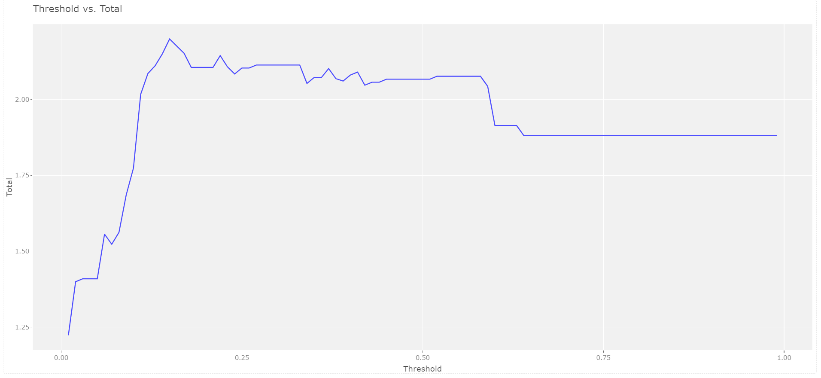
First Version of Model
75% train/test split
Run using only the three biggest factors
With default threshold (0.5):
Accuracy: 88.51%
Sensitivity: 17.65%
Specificity: 99.12%
For this version and future models, the threshold will be changed
Due to much larger number of no attrition
With threshold of 0.15:
Accuracy: 72.80%
Sensitivity: 64.71%
Specificity: 74.01%

Slide 8
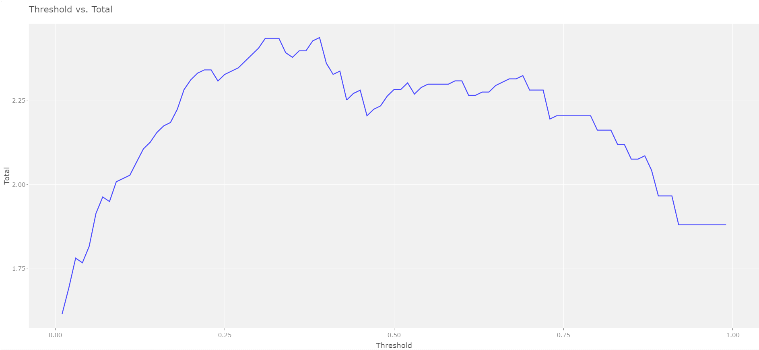
Second Version of Model
Same train/test split
High-correlation factors and the three from the highest-accuracy combination used
At a threshold of 0.39:
Accuracy: 83.03%
Sensitivity: 76.92%
Specificity: 83.85%
Higher on all three metrics compared to the first round
More factors a large reason why

Slide 9
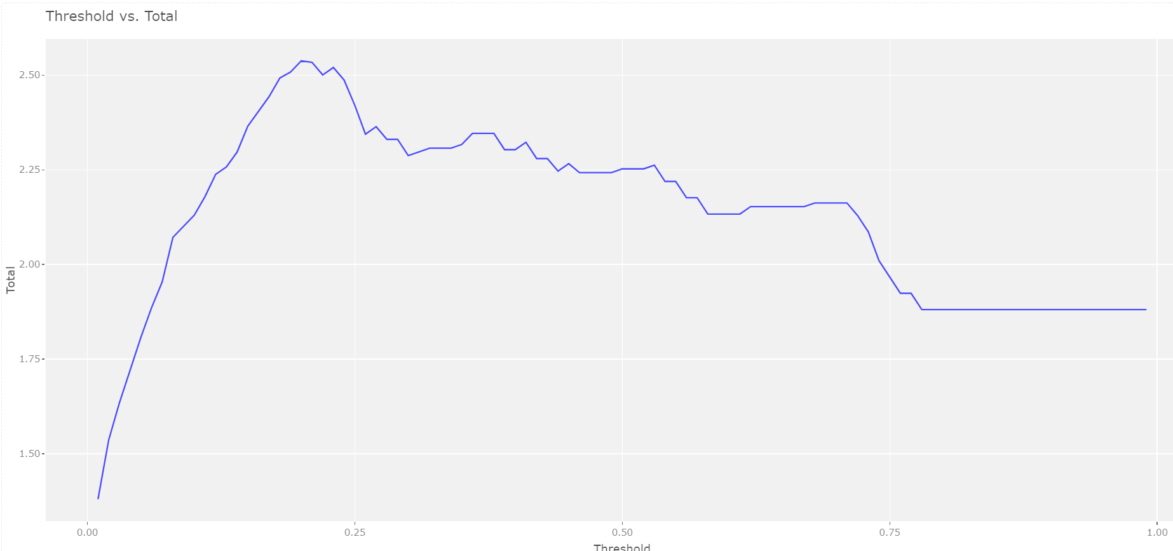
Third Version of Model
Other high-correlation factors added (Age, Years at Company, Department)
None had a positive impact
To weed out redundant factors, the model was tested many times without one of the factors
Job Level, Monthly Income, and Total Working Years found to have a non-positive impact on the total of the three metrics
At a 0.23 threshold:
Accuracy: 85.32%
Sensitivity: 80.77%
Specificity: 85.94%
Final Factors:
Job Involvement, Job Role, Marital Status, Number of Companies Worked, Overtime, Stock Option Level, and Years in Current Role

Slide 10
Final Thoughts
Third Version has over 80% on all three of the performance metrics
Much higher than the required 60%
Third Version had the highest accuracy, sensitivity, and specificity of the three adjusted-threshold models
Third Version threshold is closest to percentage of attrition in the test set
The high sensitivity and specificity show that the model doesn’t assume every employee did not attrition
Since this model uses factors which are about their current employment, it may not be as accurate for selecting new hires
Another model without these types of factors could be made in the future

Slide 11
Thank You

